Slide 1
S14: The Importance of Self-care CIH Therapies Offered by Healthcare System: Dosing and Their Combination with Provider-delivered CIH Therapies Stephanie L. Taylor, Stephen Frochen, Scott Coggeshall, Steven B. Zeliadt

Slide 2
Symposium Papers
3 teams’ studies using data from the nation’s largest survey of patients with chronic musculoskeletal pain on CIH therapy use and patient-reported outcomes from that use.
Zeliadt Paper 1) Effectiveness of using practitioner-delivered CIH therapies alone or with self-care CIH therapies on pain and pain-related conditions
Taylor Paper 2) Effectiveness of different # of sessions of yoga on health and wellness outcomes
Coggeshall Paper 3) Effectiveness of different # of sessions of meditation on health and wellness outcomes
.

Slide 3
Partners: Dr. Ben Kligler, Alison Whitehead, Dr. Janet Clark, Tammy Schult from VA Office of Patient Centered Care and Cultural Transformation (OPCC&CT) QUERI CIHEC Funding: OPCC&CT and VA Quality Enhancement Research Initiative (grant #PEC 16-354).
Patient CIH Therapy Experience Survey
CIH Therapy Patient Experience Survey Development and Data Team:
Barbara Bokhour, PhD Karl Lorenz, MD, MSHS
Claire Chen, MPH Briana Lott, MPH
Amy Cohen, PhD Michael McGowan, MA
Scott Coggeshall, PhD Marlena Shin, JD, MPH
Claudia Der-Martirosian, PhD Stephanie L. Taylor, PhD, MPH
Jamie Douglas, MA Joy Toyama, DrPH
Rani Elwy, PhD Michelle, Upham, MSW
Spencer Hildie, BS Steven B. Zeliadt, PhD, MPH
Danna Kasom, BS Xiaoyi Zhang, MS
Alexander Kloehn, MPH, RDN
Jolie Haun and her team for testing the survey

Slide 4
Patient CIH Therapy Experience Survey
Population: Sampled from VA EMR:
- invited 15,608 Veterans at 18 VA medical centers in Whole
Health Flagship program
- w moderate-to-severe chronic musculoskeletal pain
- who initiated any: chiropractic care, acupuncture, massage,
yoga, meditation/mindfulness, Tai-Chi/Qigong
Topics: CIH therapy use and outcomes
RR: - Baseline svy RR = 24% of 15k invited
- 6-month svy RR = 58% of 6,453 baseline responders
2021-2023, 4 time points: baseline, 1-mo, 3-mo, 6-mo,
Supplemented with VA EMR: CIH therapy use, covariates
Taylor SL, Elwy AR, Bokhour BG et al. Exploring Measuring Patient-Reported Use and Outcomes from Complementary and Integrative Health Therapies: Development of the CIH Therapy Patient Experience Survey. Global Advances. 2024 Apr 6

Slide 5
How the Survey Assessed Use of CIH Therapies
Methods- How the Survey Defined CIH Therapies
“ Yoga for 15+ mins; either by app, online/ in-person class, or doing it on your own after some training (..”not asking about just stretching or breathwork therapy. We are asking only about yoga)”
“Meditation, mindfulness or mantram repetition for 15 minutes of
more, either by using an app, taking an online or in-person class, or
doing it on your own after some training”
Asked about # classes or sessions:
- “doing it on your own after some training”
- “in-person with a community provider”
- “in-person with a VA provider”
- “at home guided by a VA provider”
- “at home guided by a community provider”
- “on my own, using a recording, video, or app” and “Other”
Asked about # times in past 4 weeks, and 4 weeks before that.

Slide 6
VA OPCC&CT’s Veterans’ CIH Experience Survey
Methods- The Survey Outcome Measures
Construct | Measure
Pain intensity and interference | Brief Pain Inventory (BPI) Patient Global Impression of Change (PGIC) CDC’s High Impact Chronic Pain
Overall mental health, overall physical health, fatigue, well-being | PROMIS 10 Patient Global Impression of Change (PGIC)
Depression | PHQ2
Stress | Perceived Stress Scale (PSS)
Purpose in life | Life Engagement
Ownership of one’s health/ Health efficacy | Altarum Consumer Engagement Perceived Health Competency Scale Self Eff for Managing Chronic Disease

Slide 7
Questions?

Slide 8
Combining Self-Care Complementary and Integrative Health (CIH) Therapies with Practitioner-Delivered CIH Therapies: The Assessing Pain, Patient Reported Outcomes and Complementary Health (APPROACH) Study Steven B. Zeliadt

Slide 9
APPROACH Acknowledgements
Co-PI: Stephanie L. Taylor, PhD, MPH A. Rani Elwy, PhD
Barbara Bokhour, PhD Hannah Gelman, PhD
Claire Chen, MPH Karl Lorenz, MD
Scott Coggeshall, PhD Ethan Rosser, PhD
Amy Cohen, PhD Marlena Shin, JD, MPH
Claudia Der-Martirosian, PhD Joy Toyama, DrPH
Jamie Douglas, MA Xiaoyi Zhang, MS
Member: NIH-DoD-VA Pain Management Collaboratory
https://painmanagementcollaboratory.org/
Funding: VHA SDR 17-306 ClinicalTrials.org: NCT05097521
Financial Conflicts: No investigators have any potential financial conflicts
Disclosures: The views and opinions of authors expressed herein do not necessarily state or reflect those of the United States Government and shall not be used for advertising or product endorsement purposes.

Slide 10
APPROACH Study Objective
Do Veterans with chronic pain experience better outcomes when practitioner-delivered CIH therapies are combined with self-care CIH therapies compared to practitioner-delivered therapies alone?
Practitioner-delivered CIH therapies:
acupuncture, therapeutic massage, chiropractic care
Self-care CIH therapies:
meditation/mindfulness, yoga, Tai Chi/Qigong

Slide 11
APPROACH Study Enrollment
15,619 Veterans with chronic pain identified as initiating CIH therapy between March 2021 and March 2023
Invited to participate CIH Experience Survey
3,306 survey responders met APPROACH study criteria
1,688 (51%) received practitioner-delivered (PD) CIH therapies only (≥ 1 session)
1,618 (49%) received both practitioner-delivered and self-care (PD/SC) CIH therapies (≥ 1 session of PD + ≥ 3 sessions in 90 days of SC)

Slide 12
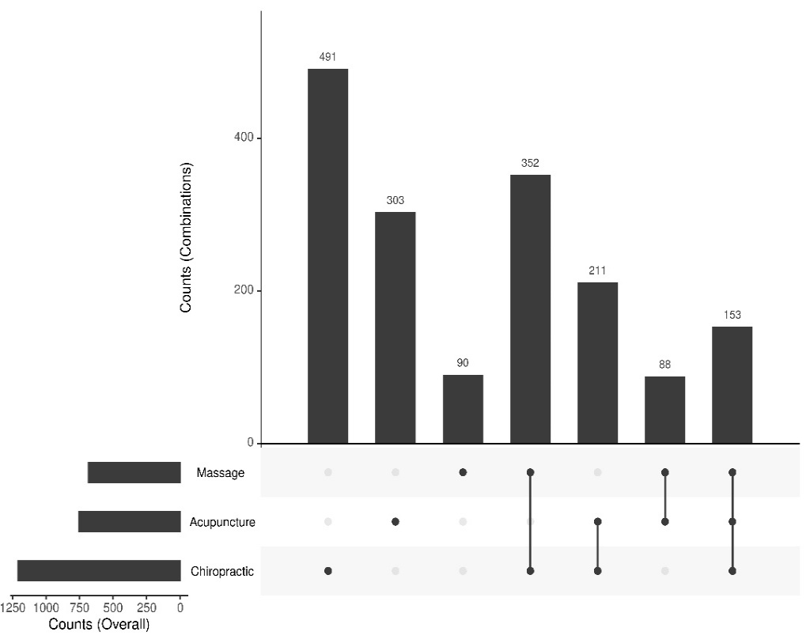
PD Arm – Exposures
PD: 72% chiropractic care, 45% acupuncture, 41% massage

Slide 13
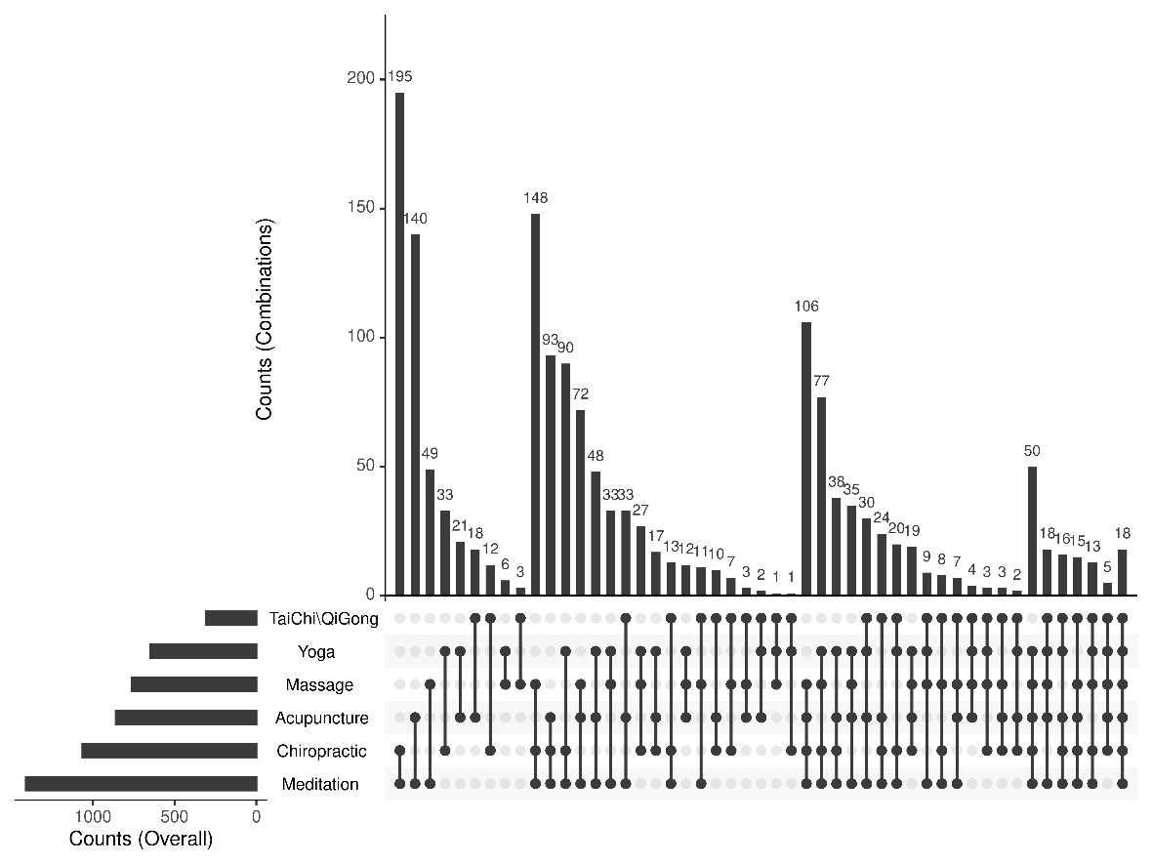
PD/SC Arm – Exposures
PD/SC: 89% received meditation, 66% chiropractic, 53% acupuncture, 47% massage, 46% yoga, 24% TaiChi/Qigong

Slide 14
Baseline Characteristics
 | PD N=1,688 | PD/SC N=1,618
Age | 59 (14) | 54 (13)
Female | 13% | 27%
Service connected ≥ 50% | 68% | 74%
Education (> High school) | 65% | 79%
Mental Health visit within 30 days | 19% | 33%
Pain Clinic visit within 30 days | 13% | 14%
Baseline Pain Severity – BPI | 5.92 | 5.99
Baseline Pain Interference – BPI | 6.30 | 6.61
PROMIS10 – Physical Health | 37.1 | 36.7
PROMIS10 – Mental Health | 40.9 | 38.9
BPI = Brief Pain Inventory

Slide 15
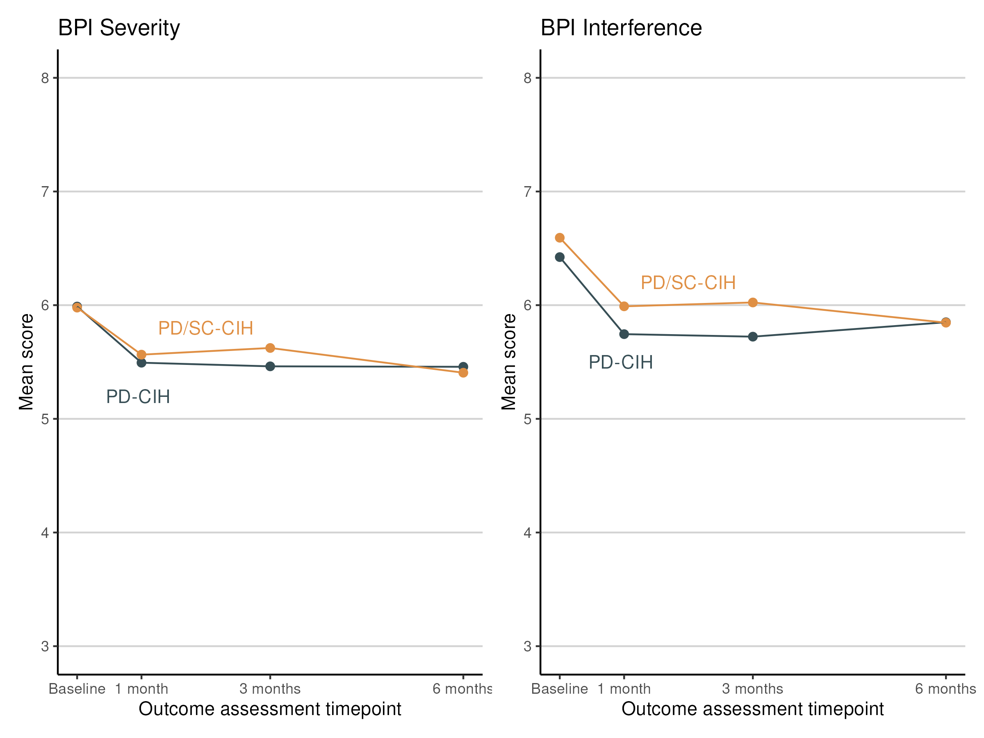
Results – BPI – Primary Outcome
Between Group Difference
-0.01 (p=0.847)
Between Group Difference
-0.12 (p=0.160)

Slide 16
Results – Patient Global Impression of Change
 | PD Arm Absolute % Improvement at 6M | PD/SC Arm Absolute % Improvement at 6M | Between Group Differences – Additional % with Improvement in PD/SC Arm (Adjusted)
PGIC – Pain | 49% | 54% | +11% (p<0.001)
PGIC – Mental Health | 28% | 44% | +24% (p<0.001 )
PGIC – Fatigue | 26% | 35% | +28% (p<0.001)
PGIC – Well-being | 40% | 53% | +27% (p<0.001)
PGIC = “Since your use of acupuncture, massage, chiropractic care, yoga, Tai Chi, Qigong, or meditation you reported over the past 6 months, how is your____ now?

Slide 17
Additional Outcomes
 | PD Arm 6M & Change (Unadjusted) | PD/SC Arm 6M & Change (Unadjusted) | Between Group Differences Improvement among PD/SC Arm (Adjusted)
BPI – Severity (0-10) | 5.3 / -0.60 | 5.4 / -0.57 | -0.01 (p=0.847)
BPI – Interference (0-10) | 5.7 / -0.63 | 5.9 / -0.73 | -0.12 (p=0.160)
PROMIS10 – Physical health (T-scores stnd mean 50) | 38.3 / +1.16 | 37.9 / +1.25 | +0.47 (p=0.024)
PROMIS10 – Mental health (T-scores stnd mean 50) | 41.5 / +0.53 | 39.7 / +0.87 | +0.46 (p=0.039)
Perceived Stress Score (0-16) | 5.68 / -0.26 | 6.39 / -0.39 | -0.09 (p=0.346)
Life Engagement Test (6-30) | 23.2 / +0.02 | 22.7 / +0.14 | +0.09 (p=0.502)

Slide 18
Conclusions
Both approaches to offering CIH therapies, practitioner-delivered alone or in combination with self-care, were equally associated with slight improvements in pain severity and interference
Veterans who combined therapies had small improvements in overall physical and mental health, and reported greater perceptions that their use of CIH helped improve pain and other dimensions of well-being
These real-world findings support healthcare systems making self-care CIH therapies available as a patient-centered option that will help some patients with chronic pain

Slide 19
Thank You
Steven.Zeliadt@va.gov & szeliadt@uw.edu
Stephanie.Taylor@va.gov & stephanietaylor@mednet.ucla.edu
Will also be presented
Oral Abstract Session 21: Interventions for Chronic Pain
Friday 3/7/2025 3:15 PM - 4:15 PM
Questions

Slide 20
What Number of Yoga Sessions is Associated with Improved Health? Stephanie Taylor, PhD paper co-authors: Stephen Frochen, Diana Burgess, Lee Cross, Marlysa Sullivan, Steve Zeliadt

Slide 21
This evaluation was conducted by the Veterans Health Administration’s (VHA’s) Complementary and Integrative Health Evaluation Center (CIHEC) as part of a quality improvement evaluation requested and funded by the VHA Office of Patient Centered Care and Cultural Transformation, and by the VHA Quality Enhancement Research Initiative (QUERI) program [PEC 16-354].
The views and opinions of authors expressed in this presentation do not necessarily state or reflect those of the Veterans Health Administration or the United States Government.

Slide 22
Partners: Dr. Ben Kligler, Alison Whitehead, Dr. Janet Clark, Tammy Schult from VA Office of Patient Centered Care and Cultural Transformation (OPCC&CT) QUERI CIHEC Funding: OPCC&CT and VA Quality Enhancement Research Initiative (grant #PEC 16-354). CIH Therapy Patient Experience Survey Development and Data Team
Acknowledgements

Slide 23
Background
Yoga interventions can improve chronic pain, anxiety, sleep, and depression.
However, the field has still not coalesced around an optimal number of yoga sessions needed for some health outcomes.
Most studies of yoga interventions understandably use a pre-set number of sessions to examine effectiveness (e.g., 6, 8, 10 sessions).
Few have examined the effectiveness of varying numbers of sessions of yoga on health to determine the optimal number of sessions.

Slide 24
Patient CIH Therapy Experience Survey
Population: Sampled from VA EMR:
- invited 15,608 Veterans at 18 VA medical centers in Whole
Health Flagship program
- w moderate-to-severe chronic musculoskeletal pain
2021-2023, 4 time points: baseline, 1-mo, 3-mo, 6-mo,
Supplemented with VA EMR: CIH therapy use, covariates

Slide 25
How the Survey Assessed Use of CIH Therapies
Methods- How the Survey Defined Meditation
“ Yoga for 15 minutes or more, either by using an app, taking an online or in-person class, or doing it on your own after some training (We are not asking about just stretching or breathwork therapy. We are asking only about yoga)”
Asked about # classes or sessions:
- “doing it on your own after some training”
- “in-person with a community provider”
- “in-person with a VA provider”
- “at home guided by a VA provider”
- “at home guided by a community provider”
- “on my own, using a recording, video, or app” and “Other”

Slide 26
How the Survey Assessed Use of CIH Therapies (cont.)
Methods- How We Determined “New” User
1) Pulled names to survey from the EMR based on patient
having no use in 6 CIH therapies past 6 mos.
2) Confirm with survey responses to the question asking # of
times used in past 8 wks.
3) Dropped “consistent” meditation users –
people who said they used
a) consistently (2+/wk) or
b) somewhat consistently used (~ 1x/wk) for 15+ mins or
more for past 6 months.

Slide 27
VA OPCC&CT’s Veterans’ CIH Experience Survey
Methods- The Survey Outcome Measures
Construct | Measure
Pain intensity and interference | Brief Pain Inventory (BPI)
Overall mental health, overall physical health, fatigue | PROMIS 10
Feeling depressed | PHQ2
Stress | Perceived Stress Scale (PSS)
Purpose in life | Life Engagement

Slide 28
Methods: Analysis
Restricted cubic spline (natural spline) regression
- Linear estimators for continuous outcomes (pain, physical
health, mental health, stress, and having a purpose in life)
- Multinomial estimators for categorical outcomes (depression,
fatigue)
Covariates and controls
- # sessions used at baseline, use of other 6 CIH therapies
- Demographic chars (gender, age, race, ethnicity)
- Other pain tx (opioid use, pain clinic use, physical therapy
use, spinal injections, number of pain sites on body)
- Health comborbidities (Elixhauser)
- Mental health utilization (MH care could diminish sx)

Slide 29
Draft Results: The # of Yoga Sessions Assoc. with Changes
 | During the 3 mos, having at least… | During the 6 mos, having at least…
Pain Interference w Life | NS | 5+ sessions
Pain Severity | 19+ sessions | 17+
Overall Physical Health | 14+ | 19+
Overall Mental Health | 16+ | 39+
Perceived Stress | NS | 21+
Purpose in Life | 18+ | 19+
Feeling depressed
Several/Half of the Days | 13+ | NS
Nearly Every Day | 20+ | 81+*
Fatigue
Moderate | 15+ | NS
Severe | 1+ | 8+
* So few people had this many sessions that we have to interpret this result with caution

Slide 30
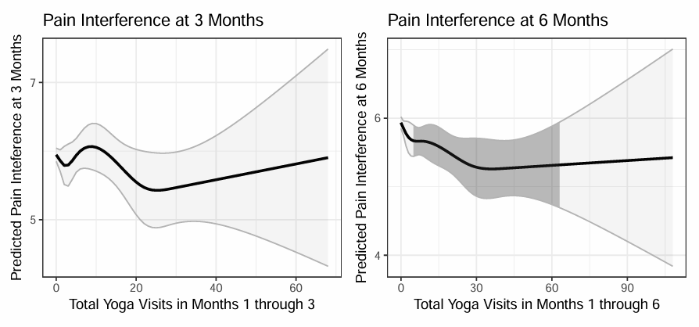
At 3 months, using yoga was unassociated with a change in pain interference. At 6 months, having 5-62 sessions was assoc. with decreased pain interference.
Yoga: Pain Interference
5

Slide 31
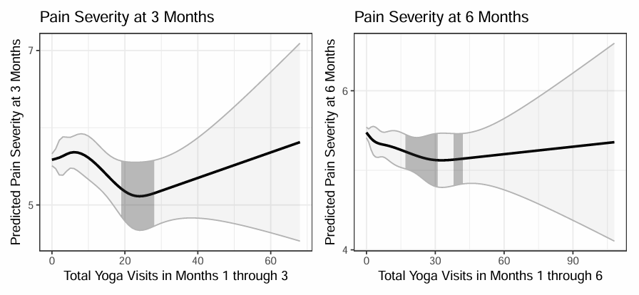
Yoga: Pain Severity
At 3 months, having 19-27 sessions yoga was associated w decreased pain severity.
At 6 months, having 7-41 sessions was too.
17
19
17
19

Slide 32
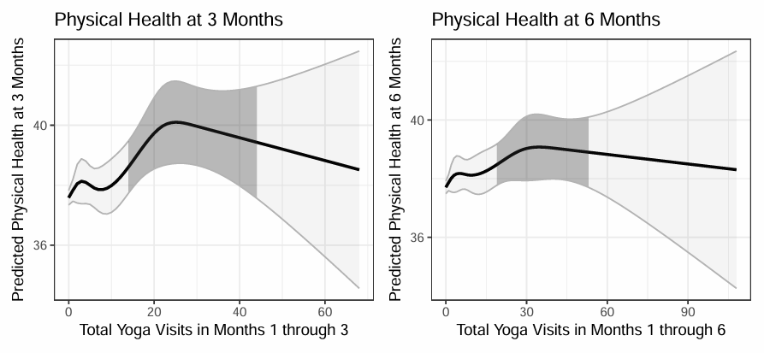
Yoga: Global Physical Health
At 3 months, having 14-43 yoga sessions was assoc. w increased global physical health. At 6 months, having 19-52 sessions was too.
14
19

Slide 33
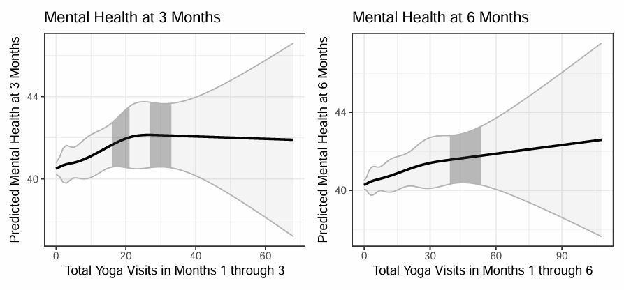
Yoga: Global Mental Health
At 3 months, having 16-32 yoga sessions was assoc. w increased global mental health. At 6 months, using 39-52 sessions was too.
16
39

Slide 34
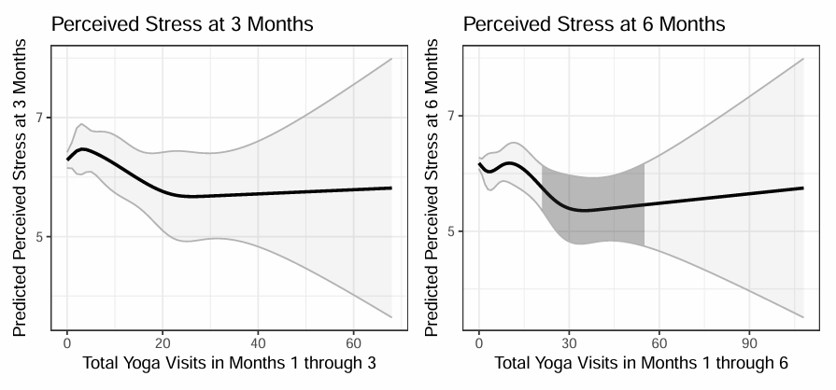
Yoga: Perceived Stress
At 3 months, using yoga was unassociated with a change in perceived stress. At 6 months, however, using 21-54 sessions was assoc. w decreased perceived stress.
21

Slide 35
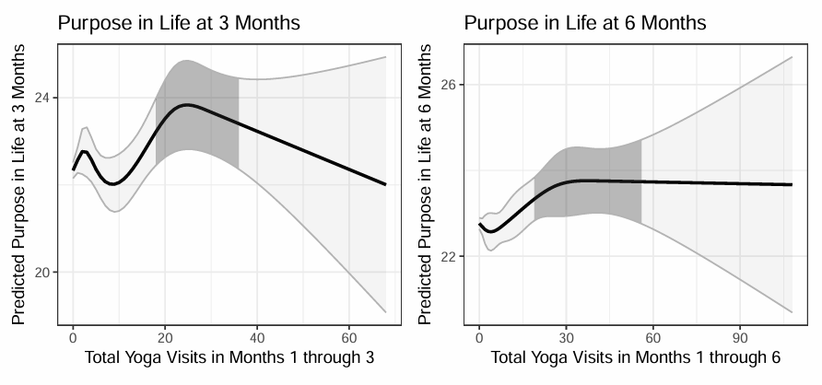
Yoga: Purpose in Life
At 3 months, having 18-35 yoga sessions was assoc. w an increased purpose in life. At 6 months, using 19-55 sessions was too.
18
19

Slide 36
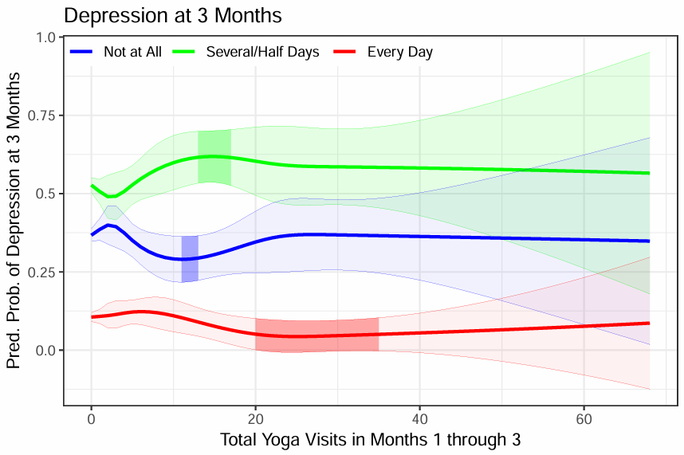
Yoga: Depression
At 3 months, having 13-16 sessions of yoga was assoc. with a decrease in the probability of feeling depressed several/half days each week.
Having 20-34 sessions was assoc. w a decrease in in the probability of feeling depressed every day/week.
13
11
20

Slide 37
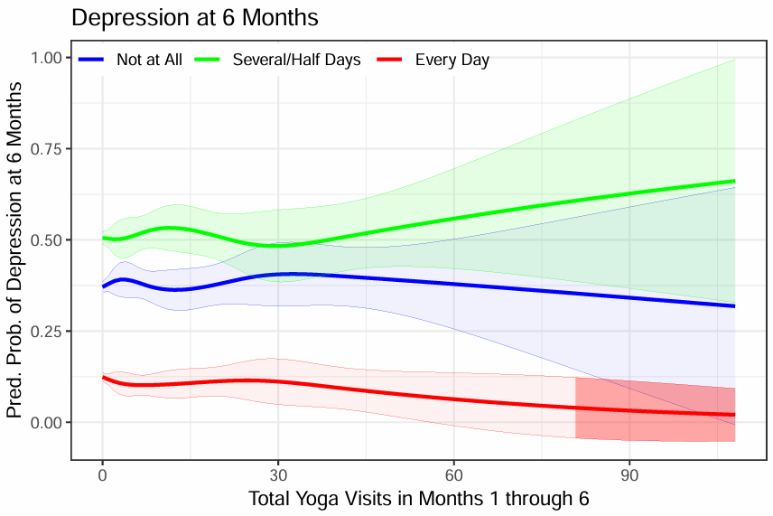
Yoga: Depression
At 6 months ~(180 days), using yoga wasn’t assoc. with depression.
Too few people had 81+ sessions, so these results aren’t stable/ meaningful.
81

Slide 38
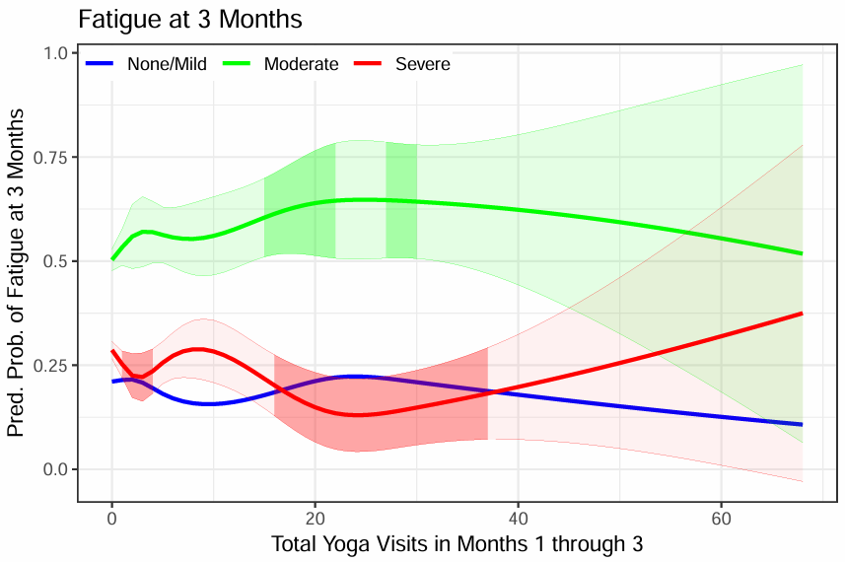
Yoga: Fatigue
At 3 months, having 15-29 sessions of yoga was assoc. with an increase in the probability of having fatigue several/half days per week.
Having 1-3 and 16-37 yoga sessions was assoc. w a decrease in the probability of having fatigue every day in a week.
15
1

Slide 39
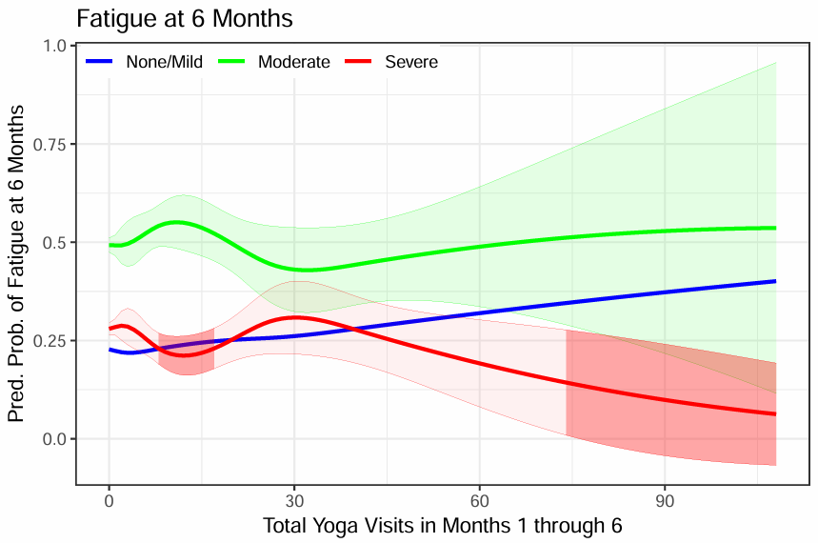
Yoga: Fatigue
At 6 months, having 8-17 sessions and 74+ sessions was associated with a decrease in the probability of having fatigue every day.
But so few people had 74+ visits, the results are unstable/unmeaningful.
8

Slide 40
Limitations
This is a quasi-experimental study, so we can’t make statements about causality.
Survey non-response may reduce precision and bias the estimates and predictions.
People generally used either few meditation sessions over 6-month period, or too few people used high amounts.

Slide 41
Summary
Having as little as 14 or 19 yoga sessions over 3 months was assoc. w improvements in pain severity, physical health, mental health.
The pattern was similar over 6 months, using yoga now was assoc. w improvements in stress and pain interfering with life.
However, the pattern is odd for fatigue and depression; using yoga was assoc. w improvements only for those w daily fatigue or daily feelings of depression. It had the opposite relationship for those with feeling fatigue or depression half the days.

Slide 42
Thank You
Stephanie.Taylor@va.gov & stephanietaylor@mednet.ucla.edu
Will also be presented
Oral Abstract Session 22: Interventions Delivery and Dose
Friday 3/7/2025 3:15 PM - 4:15 PM
Questions ?

Slide 43
What Number of Meditation Sessions is Associated with Improved Health? Scott Coggeshall, PhD paper co-authors: Stephen Frochen, Diana Burgess, Lee Cross, Marlysa Sullivan, Steve Zeliadt, Stephanie L. Taylor

Slide 44
This evaluation was conducted by the Veterans Health Administration’s (VHA’s) Complementary and Integrative Health Evaluation Center (CIHEC) as part of a quality improvement evaluation requested and funded by the VHA Office of Patient Centered Care and Cultural Transformation, and by the VHA Quality Enhancement Research Initiative (QUERI) program [PEC 16-354].
The views and opinions of authors expressed in this presentation do not necessarily state or reflect those of the Veterans Health Administration or the United States Government.

Slide 45
Partners: Dr. Ben Kligler, Alison Whitehead, Dr. Janet Clark, Tammy Schult from VA Office of Patient Centered Care and Cultural Transformation (OPCC&CT) QUERI CIHEC Funding: OPCC&CT and VA Quality Enhancement Research Initiative (grant #PEC 16-354). CIH Therapy Patient Experience Survey Development and Data Team
Acknowledgements

Slide 46
Background
Meditation interventions can improve chronic pain, anxiety, sleep, and depression.
However, the field has still not coalesced around an optimal number of meditation sessions needed for some health outcomes.
Most studies of meditation interventions understandably use a pre-set number of sessions to examine effectiveness (e.g., 6, 8, 10 sessions).
Few have examined the effectiveness of varying numbers of sessions of meditation on health to determine the optimal number of sessions.

Slide 47
Patient CIH Therapy Experience Survey
Population: Sampled from VA EMR:
- invited 15,608 Veterans at 18 VA medical centers in Whole
Health Flagship program
- w moderate-to-severe chronic musculoskeletal pain
2021-2023, 4 time points: baseline, 1-mo, 3-mo, 6-mo,
Supplemented with VA EMR: CIH therapy use, covariates

Slide 48
How the Survey Assessed Use of CIH Therapies
Methods- How the Survey Defined Meditation
“Meditation, mindfulness or mantram repetition for 15 minutes
or more, either by using an app, taking an online or in-person
class, or doing it on your own after some training”
Asked about # classes or sessions:
- “doing it on your own after some training”
- “in-person with a community provider”
- “in-person with a VA provider”
- “at home guided by a VA provider”
- “at home guided by a community provider”
- “on my own, using a recording, video, or app” and “Other”

Slide 49
How the Survey Assessed Use of CIH Therapies (cont.)
Methods- How We Determined “New” User
1) Pulled names to survey from the EMR based on patient
having no use in 6 CIH therapies past 6 mos.
2) Confirm with survey responses to the question asking # of
times used in past 8 wks.
3) Dropped “consistent” meditation users –
people who said they used
a) consistently (2+/wk) or
b) somewhat consistently used (~ 1x/wk) for 15+ mins or
more for past 6 months.

Slide 50
VA OPCC&CT’s Veterans’ CIH Experience Survey
Methods- The Survey Outcome Measures
Construct | Measure
Pain intensity and interference | Brief Pain Inventory (BPI)
Overall mental health, overall physical health, fatigue | PROMIS 10
Feeling depressed | PHQ2
Stress | Perceived Stress Scale (PSS)
Purpose in life | Life Engagement

Slide 51
Methods: Analysis
Restricted cubic spline (natural spline) regression
- Linear estimators for continuous outcomes (pain, physical
health, mental health, stress, and having a purpose in life)
- Multinomial estimators for categorical outcomes (depression,
fatigue)
Covariates and controls
- # sessions used at baseline, use of other 6 CIH therapies
- Demographic chars (gender, age, race, ethnicity)
- Other pain tx (opioid use, pain clinic use, physical therapy
use, spinal injections, number of pain sites on body)
- Health comborbidities (Elixhauser)
- Mental health utilization (MH care could diminish sx)

Slide 52
The # of Meditation Sessions Assoc. with Changes
 | During 3 mos, having at least… | During 6 mos, having at least…
Pain Interference in Life | 10+ sessions | NS
Pain Severity | NS | NS
Overall Physical Health | NS | NS
Overall Mental Health | NS | 15+ sessions
Perceived Stress | 1+ | 32+
Life Purpose | NS | 1+
Depression
Several/Half of the Days | 1+ | NS
Nearly Every Day | 33+ | NS
Fatigue
Moderate | 21+ | NS
Severe | 56+ * | NS
* So few people had this many sessions that we have to interpret this result with caution

Slide 53
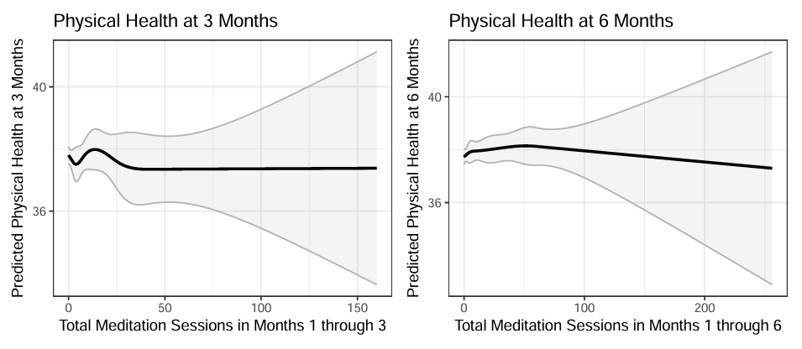
Using meditation was unassociated with a change in global physical health at both 3 and 6 months.
Meditation: Global Physical Health

Slide 54
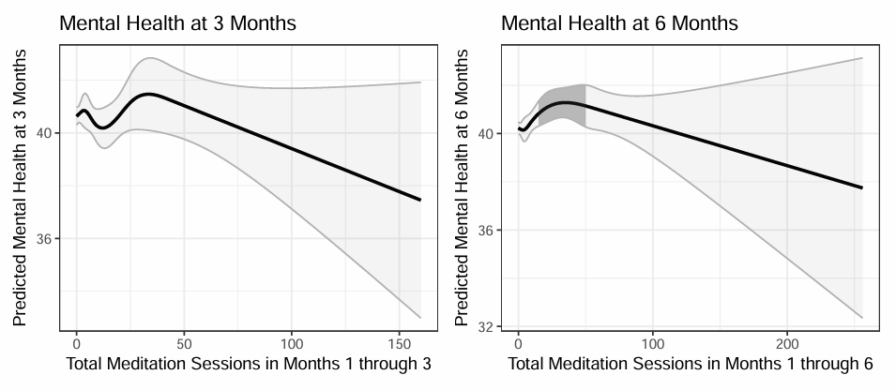
At 3 months, using meditation was unassociated w global mental health. At 6 months, using 15-49 sessions of meditation was assoc. w an increase in global mental health.
Meditation: Global Mental Health
15

Slide 55
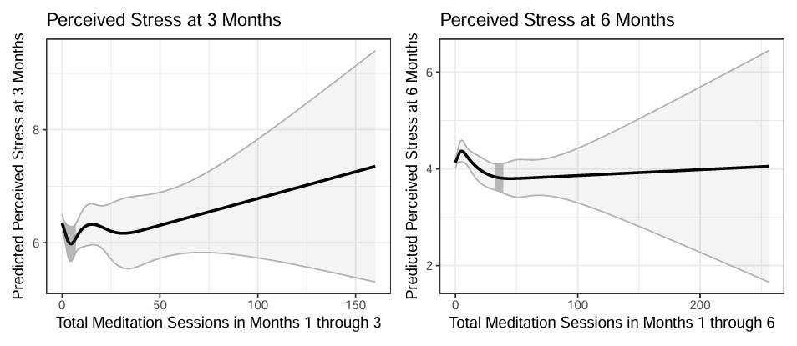
At 3 months, using 1-6 sessions of meditation use was assoc/ with a decrease in perceived stress. At 6 months, using 32-38 sessions was too.
Meditation: Perceived Stress
32
1

Slide 56
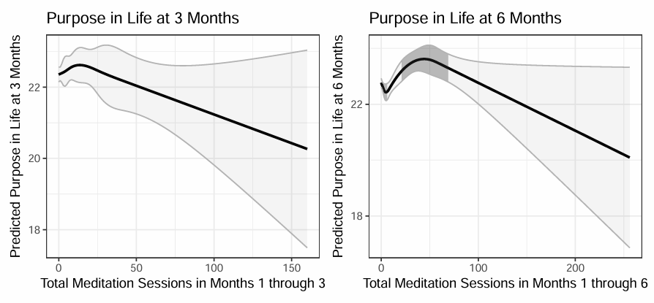
At 3 months, using meditation was unassoc. w having purpose in life. However, by 6 months, having 1-5 sessions was associated w a decrease in having purpose in life, but having 21-68 sessions was assoc. with an increase.
Meditation: Purpose in Life
1

Slide 57
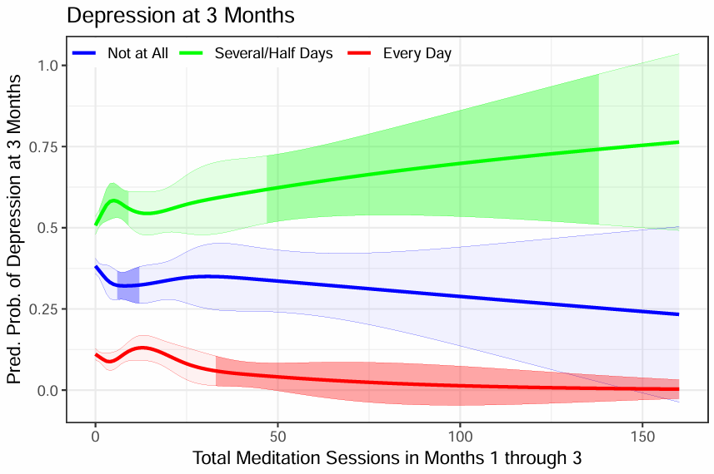
Meditation: Depression
At 3 months, having 1-9 sessions was assoc. w an increase in the probability of feeling depressed several/half days per week.
While having 33+ sessions was assoc. with a decrease in the probability of feeling depressed every day.
1
6
33

Slide 58
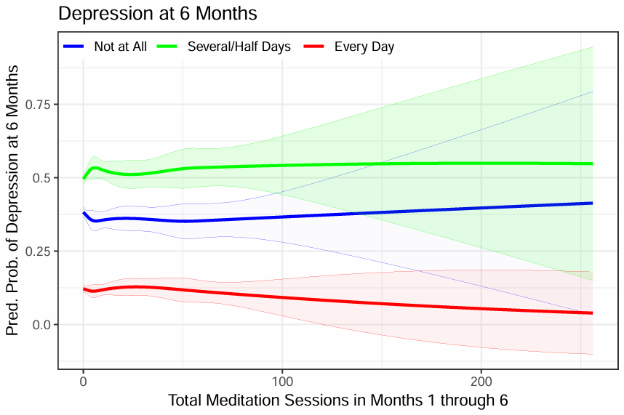
Meditation: Depression
At 6 months, meditation use was not associated with feeling depressed.

Slide 59
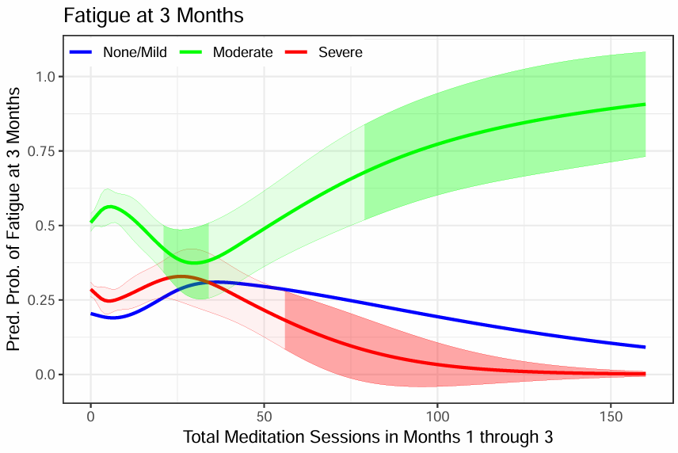
Meditation: Fatigue
At 3 months, using 21+ sessions of meditation was assoc. w a decrease in the probability of having moderate fatigue
Having 56+ visits was associated w a decrease in the prob. of severe fatigue.
21
56

Slide 60
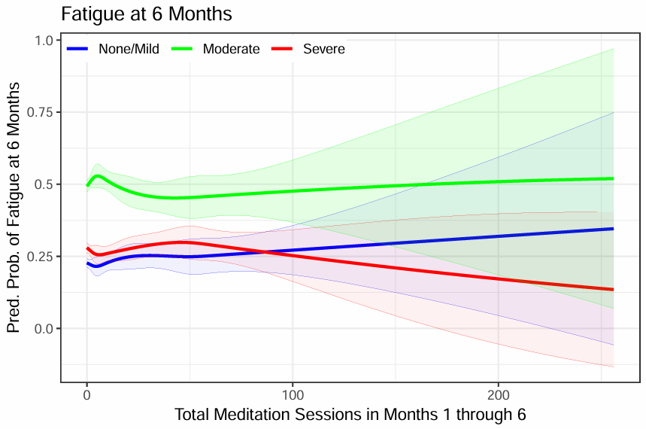
Meditation: Fatigue
At 6 months, meditation use was not associated with fatigue.

Slide 61
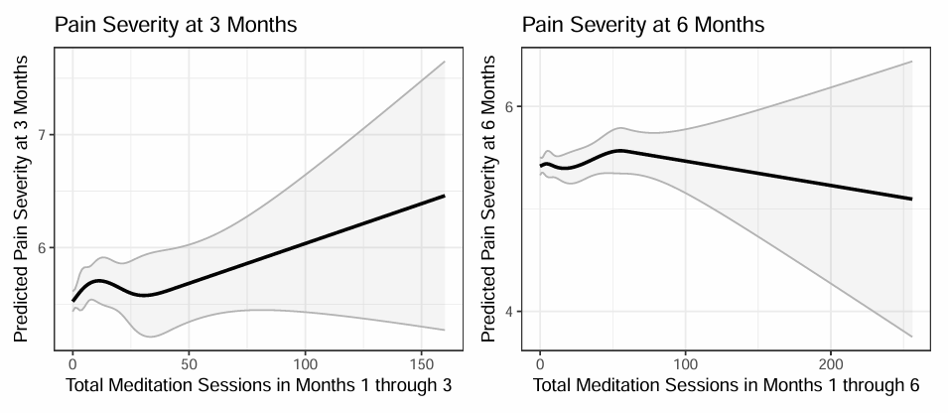
Using meditation was unassociated with a change in pain severity at either 3 or 6 months.
Meditation: Pain Severity

Slide 62
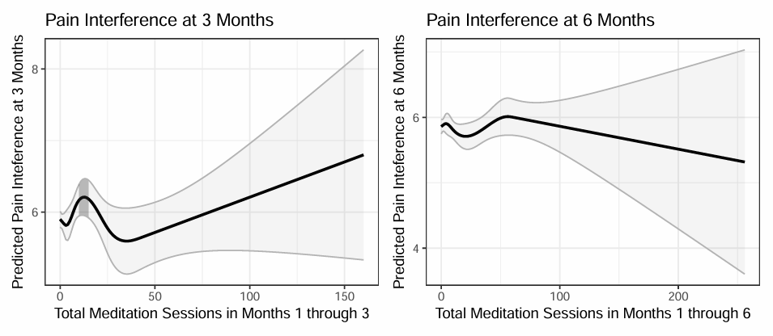
At 3 months, using 10-14 sessions of meditation use was associated w an increase in pain interference. At 6 months, meditation use was unassociated with pain interference.
Meditation: Pain Interference
10

Slide 63
Limitations
This is a quasi-experimental study, so we can’t make statements about causality.
Survey non-response may reduce precision and bias the estimates and predictions.
People generally used either few meditation sessions over 6-month period, or too few people used high amounts.

Slide 64
Summary
Having as little as 1 meditation session in 3 months or 28+ meditation sessions over 6 mos was associated with improvements in stress.
Having 13+ sessions over 6 months was assoc. w improvements in overall mental health.
But, having 9+ sessions over 3 months was assoc. w pain interfering with life more.
And just as with yoga, the pattern is odd for depression; using meditation was assoc. w improvements only for those w daily feelings of depression. It had the opposite relationship for those feeling depressed half the days.

Slide 65
Thank You
Scott.Coggeshall@va.gov
Stephanie.Taylor@va.gov & stephanietaylor@mednet.ucla.edu
Questions ?

